Slide 1
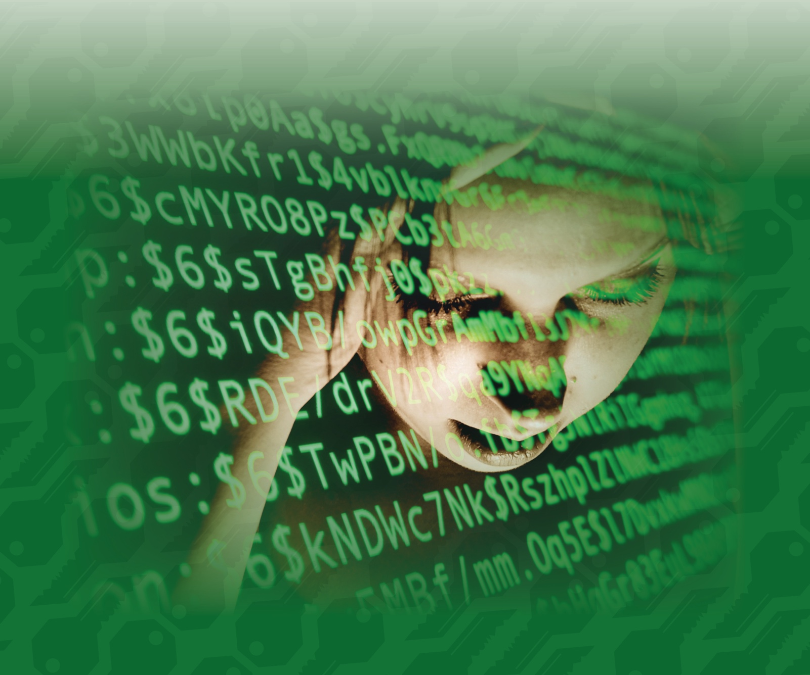
Saving Face:
Information Tricks for Life and Love
National Museum of Mathematics
Math Encounters
Wednesday, May 4, 2016
Tom Verhoeff
Eindhoven University of Technology
The Netherlands
Notes:
A great honor to be invited
Yahtzee, mathematical art, model-based software engineering, combinatorics

Slide 2
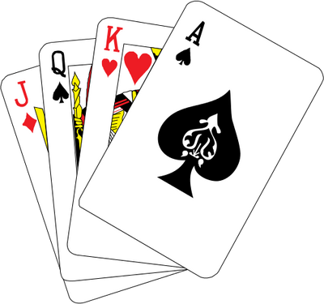
Any-Card-Any-Number (ACAN) Trick
1 volunteer
27 playing cards
1 magician
3 questions
Notes:
Where are you from (what branch of mathematics)?
Each question is a ternary question

Slide 3
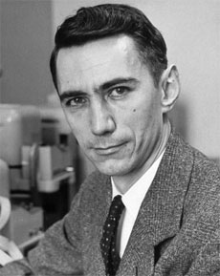
‘A Mathematical Theory of Communication’
Shannon (1948): “The fundamental problem of communication is that of reproducing at one point either exactly or approximately a message selected at another point.”
Notes:
2016 = Shannon Centennial
Mathematician, electrical engineer, founding father of Information Theory

Slide 4
Setting for Information Theory
Problem: Communication and storage of information
Compression for efficient communication
Protection against noise for reliable communication
Protection against adversary for secure communication
Sender
Channel
Receiver
Storer
Memory
Retriever
Notes:
Not modified by computation, but communicated/stored ‘as is’
But this still involve many computations.
Major applications: telephony, radio/television broadcasting, internet
We will usually speak about “channel”, but that can also mean “memory”.

Slide 5
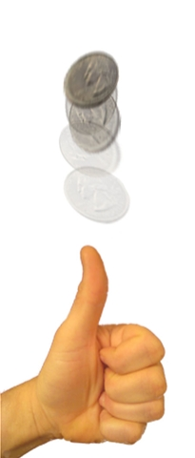
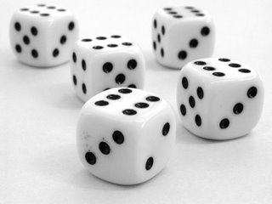
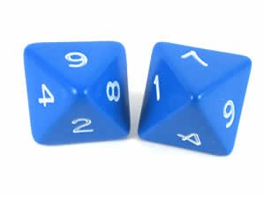
How to Measure Information? (1)
The amount of information received depends on:
  The number of possible messages
  More messages possible ⇒ more information
  The outcome of a dice roll versus a coin flip
Notes:
Qualitative understanding of information
Encode each coin flip in one bit (0 vs 1), and a card “color” in 2 bits
Encode each dice roll in … bits: 2 not enough, 3 is “overkill”
log₂ N bits, where N is number of messages to be distinguished
Can you encode each of the 6 dice rolls into log₂ 6 = 2.585 bits? On average, yes

Slide 6
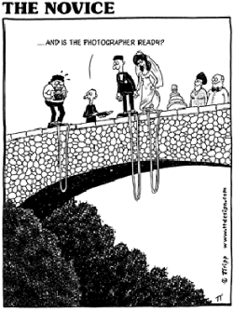

How to Measure Information? (2)
The amount of information received depends on:
  Probabilities of messages
  Lower probability ⇒ more information
Notes:
Qualitative understanding of information
Answer ‘Yes’ versus ‘No’ to ‘Will you marry … ?’

Slide 7
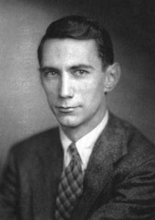
Quantitative Definition of Information
Due to Shannon (1948)
Let P(A) be the probability of answer A:
  0 ≤ P(A) ≤ 1 (probabilities lie between 0 and 1)
  (probabilities sum to 1)
Amount of information (measured in bits) in answer A:
Notes:
Shannon (1948): in particular, he incorporated the role of probability
Bit a.k.a. Shannon (don’t confuse with memory sizes);
Need not be integral: P(A) = 1/1024 give I(A) = 10
P(A) = 1023/1024 gives IA) = 0.0014
Why the minus sign? Otherwise it would be negative (probabilities are ≤ 1)
Why a logarithm? There are 2^{N} sequences of N bits.
log pq = log p + log q

Slide 8
Five-Card Trick
1 assistant
52 playing cards
1 magician
5 selected cards
Notes:
Show trick with sorted deck of 27 playing cards.
Explanation (to be shown later, using 27 SET cards)
Each question is a ternary question about one aspect:
Is it a squiggle, rectangle, or ellipse?
Is it red, blue, or green?
Are there one, two, or three objects?
Also observe what is invariant under the reordering of the cards

Slide 9
How Does it Work?
Use four face-up cards to encode the face-down card
Pigeonhole Principle:
  5 cards contain a pair of the same suit
    One lower, the other higher (cyclicly)
Values of this pair differ at most 6 (cyclicly)
Encoding of face-down card
  Suit: by suit of the rightmost face-up card
  Value: by adding rank of permutation of middle 3 cards
    There are 3! = 3 x 2 x 1 = 6 permutations of 3 cards

Slide 10
Shannon’s Source Coding Theorem (1948)
There is a precise limit on lossless data compression: the source entropy
Entropy H(S) of information source S:
  Average amount of information per message
Modern compression algorithms get very close to that limit
Sender
Encoder
Channel
Decoder
Receiver
Notes:
Upper and lower bounds on efficient lossless communication

Slide 11
Number Guessing with Lies
Also known as Ulam’s Game
Needed: one volunteer, who can lie
Notes:
See separate slide set: Ulam’s Game

Slide 12
The Game
Volunteer picks a number N in the range 0 through 15 (inclusive)
Magician asks seven Yes–No questions
Volunteer answers each question, and may lie once
Magician then tells number N, and which answer was a lie (if any)
How can the magician do this?
Notes:
Could ask every question twice, three times

Slide 13
Question Q₁
Is your number one of these:
1, 3, 4, 6, 8, 10, 13, 15

Slide 14
Question Q₂
Is your number one of these?
1, 2, 5, 6, 8, 11, 12, 15

Slide 15
Question Q₃
Is your number one of these?
8, 9, 10, 11, 12, 13, 14, 15

Slide 16
Question Q₄
Is your number one of these?
1, 2, 4, 7, 9, 10, 12, 15

Slide 17
Question Q₅
Is your number one of these?
4, 5, 6, 7, 12, 13, 14, 15

Slide 18
Question Q₆
Is your number one of these?
2, 3, 6, 7, 10, 11, 14, 15

Slide 19
Question Q₇
Is your number one of these?
1, 3, 5, 7, 9, 11, 13, 15

Slide 20
How Does It Work?
Place the answers a_{i} in the diagram
Yes ➔ 1, No ➔ 0
For each circle, calculate the parity
  Even number of 1’s is OK
  Circle becomes red, if odd
No red circles ⇒ no lies
Answer inside all red circles and outside all black circles was a lie
Correct the lie, and calculate N = 8 a₃ + 4 a₅ + 2 a₆ + a₇
a₁
a₅
a₃
a₇
a₄
a₆
a₂
Notes:
Parity of a number k = 0 if k is even, else 1
With children, you can tell them they must lie at least six times.
How does that work?
Hamming (7,4) code: perfect code, 7 lies, 1 no lies: 8 possibilities needs 3 bits

Slide 21
Hamming (7,4) Error-Correcting Code
4 data bits
  To encode number from 0 to 15 (inclusive)
3 parity bits (redundant)
  To protect against at most 1 bit error
A perfect code
  8 possibilities: 7 single-bit errors + 1 without error
  Needs 3 bits to encode
Invented by Richard Hamming in 1950

Slide 22
Shannon’s Channel Coding Theorem (1948)
There is a precise limit on efficiency loss in a noisy channel to achieve almost-100% reliability: the effective channel capacity
Noise is anti-information
Capacity of noisy channel = 1 – Entropy of the noise
Modern error-control codes gets very close to that limit
Sender
Encoder
Channel
Decoder
Receiver
Noise
Notes:
Upper and lower bounds on reliable lossless communication
Anit-information: people are willing to pay for that, in casinos, lotteries, etc.

Slide 23
Applications of Error-Control Codes
International Standard Book Number (ISBN)
Universal Product Code (UPC)
International Bank Account Number (IBAN)

Slide 24
Secure Communication
Situation and terminology
Sender ➔ Alice; Receiver ➔ Bob; Enemy ➔ Eve (eavesdropper)
Unencoded / decoded message ➔ plaintext
Encoded message ➔ ciphertext
Encode / decode ➔ encrypt / decrypt (or sign / verify)
Eve
Enemy
Alice
Bob
Sender
Encoder
Channel
Decoder
Receiver
Plaintext
Encrypt
Sign
Ciphertext
Decrypt
Verify
Plaintext
Notes:
Note the double arrow between channel and enemy

Slide 25
Information Security Concerns
Confidentiality: enemy cannot obtain information from message
  E.g. also not partial information about content
Authenticity: enemy cannot pretend to be a legitimate sender
  E.g. send a message in name of someone else
Integrity: enemy cannot tamper with messages on channel
  E.g. replace (part of) message with other content unnoticed
Enemy
Enemy
Enemy
1.
2.
3.
Channel
Channel
Channel
Notes:
There are more security concerns:
Availability, cf. Denial of Service attack
Non-Repudiation: cannot deny that you had that message
E.g. you should not be able to deny later that you initiated a money transfer.
But they are outside the scope of this course.

Slide 26
Kerckhoffs’ Principle (1883)
Kerckhoffs: “A cryptosystem should be secure, even if everything about the system, except the key, is public knowledge”
  The security should be in the difficulty of getting the secret key
Shannon: “the enemy knows the system being used”
  “one ought to design systems under the assumption that the enemy will immediately gain full familiarity with them”
No security through obscurity
Notes:
A key is any selectable parameter
Shannon (1945, 1949): “Communication Theory of Secrecy Systems”
Many people will need to know the algorithms
Someone will eventually leak them (bribed, tortured, loose lipped, dissatisfied, disillusioned)

Slide 27
One-Time Pad for Perfect Confidentiality
Sender and receiver somehow agree on uniformly random key
  One key bit per plaintext bit
  One-time pad contains sheets with random numbers, used once
Encode: add key bit to plaintext bit modulo 2 ➔ ciphertext bit
  0 ⊕ 0 = 0; 1 ⊕ 0 = 1; 0 ⊕ 1 = 1; 1 ⊕ 1 = 0
Decode: add key bit to ciphertext bit modulo 2 (same as encode!)
Enemy
Sender
Encoder
Channel
Decoder
Receiver
Key
Key
Notes:
Addresses: Confidentiality, using a pre-shared key
Addition modulo 2 = exclusive-or = XOR; subtraction = addition
Shannon: entropy of uniformly random key = 1; swamps plaintext for enemy
H(plaintext ⊕ key) = 1, even if H(plaintext) < 1; evens out statistical fingerprint
Trying all keys does not help.
When challenged: can construct new key to reveal any plaintext!

Slide 28






One-Time Pad Is Perfect, Two-Times Not
⊕
=
⊕
=
⊕
=
Notes:
Key is like p=0.5 noise; hence, ciphertext also
Also suitable for secret sharing

Slide 29
Classical Crypto = Symmetric Crypto
Sender and receiver share a secret key
Enemy
Sender
Encoder
Channel
Decoder
Receiver
Key
Key

Slide 30
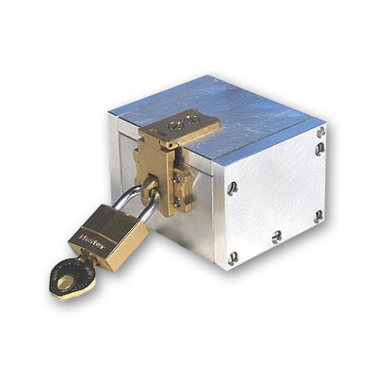
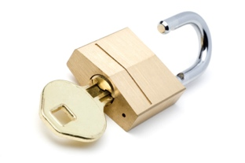
Security without Shared Keys: Challenge
Alice and Bob each have their own padlock-key combination
  Lock A with key A
  Lock B with key B
They have a strong box that can be locked with padlocks
How can Alice send a message securely to Bob?
  Without also sending keys around

Slide 31
Shamir’s Three-Pass Protocol (1980s)
Insecure
channel
Alice
Bob
Notes:
How to do this with an elephant in a cage?

Slide 32
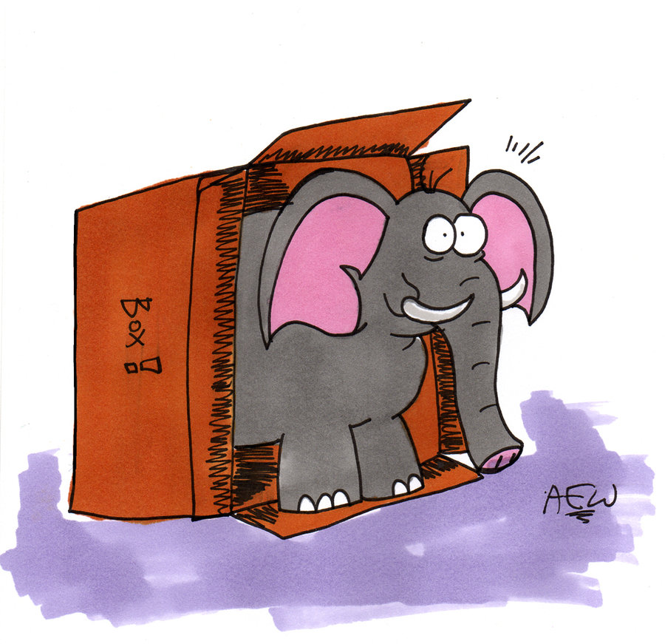
Hybrid Crypto
Symmetric crypto is fast
  But requires a shared secret key
Asymmetric crypto is slow
  But does not require shared secret key
Use asymmetric crypto to share a secret key
Use symmetric crypto on the actual message
Used on the web with https
Practical hybrid crypto: Pretty Good Privacy (PGP)
  Gnupg.org
Notes:
This is what happens when browsing the web with https

Slide 33
Diffie and Hellman Key Exchange (1976)
First published practical public-key crypto protocol
  "New directions in cryptography"
  How to establish a shared secret key over an open channel
  Based on modular exponentiation
  Secure because discrete logarithm problem is hard
Received the 2016 ACM Turing Award

Slide 34
Man-in-the-Middle Attack Visualized

Slide 35
Secure Multiparty Computation
2 volunteers
5 sectors
1 spinner
Notes:
Determine average salary of a group of people

Slide 36
Modern Crypto Applications
Digital voting in elections, bidding in auctions
  You can verify that your vote / bid was counted properly
  Nobody but you knows your vote / bid
Anonymous digital cash
  Can be spent only once
  Cannot be traced to spender
Digital group signatures
Notes:
Bitcoin
Indistinguishability Obfuscation

Slide 37
Digital Communication Stack
Efficiency:
Remove
Redundancy
Security:
Increase
Complexity
Reliability:
Add
Redundancy
Source
Encoder
Sign &
Encrypt
Channel
Encoder
Sender
Noise
Channel
Enemy
Source
Decoder
Decrypt
& Verify
Channel
Decoder
Receiver
Notes:
Also continuous variants

Slide 38
Conclusion
Information
  How to quantify: information content, entropy, channel capacity
Shannon Centennial
  Shannon’s Source and Channel Coding Theorems (1948)
  Limits on efficient and reliable communication
Cryptography
  One-Time Pad for perfect secrecy, and secret sharing
  Symmetric crypto is fast, but needs shared keys
  Asymmetric crypto is slow, but needs no shared keys
  Hybrid crypto
  Secure Multiparty Computation

Slide 39
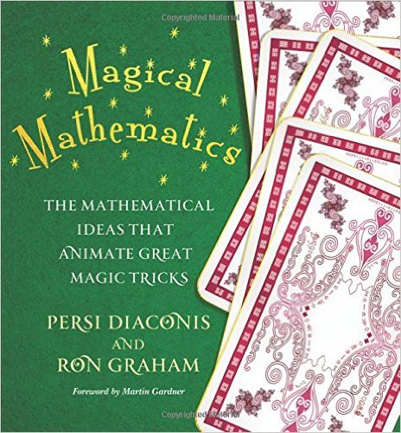
Literature

Slide 40
Workshop
Do some of these tricks yourself

Slide 41
ACAN Trick
Notes:
Show in variant with 27 SET cards, and the structural invariant
Questions boils down to:
Is it a squiggle, rectangle, or ellipse?
Is it red, blue, or green?
Are there one, two, or three objects?
Also observe what is invariant under the reordering of the cards

Slide 42
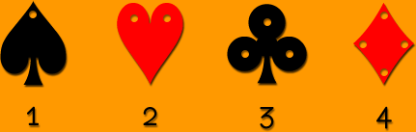
Five-Card Trick
Card suit order:
Card value order: 1, 2, 3, 4, 5, 6, 7, 8, 9, 10, J (11), Q (12), K (13=0)
Permutation ranking to encode distance
(You do need an accomplice!)

Slide 43
Ulam’s Game: Number Guessing with Lies
Questions 3, 5, 6, 7: binary search (high / low guessing)
Questions 1, 2, 4: redundant (check) questions
  Chosen such that each circle contains even number of Yes

